Slide 1
Title Slide
Video Conferencing Application
GLA University, Mathura
Department of Computer Science and Engineering
30th November, 2023

Slide 2
Introduction
A dynamic and innovative app-based communication platform developed to facilitate real-time conversation among users.
The project incorporates a real-time Video Conferencing Application.
Users can expect a modern and secure platform that revolutionizes communication by seamlessly connecting individuals in real-time.

Slide 3
Objectives
To achieve a real-time communication between our users through Online.
A user interface that will prioritize ease of use and intuitive navigation.
To provide user authentication mechanisms, allowing an authorized user access.
Responsive and adaptable to various screen sizes, allowing the users to Video Conferencing on different devices.

Slide 4
Problem Statement
A real-time Online-based communication android application.
The Video Conferencing application is important because it provides a Seamless video calling experience. User authentication has also been incorporated which leads to a secure platform for communication.
Seamless integration of Java , XML and FireBase components, enhancing overall efficiency.

Slide 5
Literature Review
The project will provide a secure way of communication(conferencing) between its users by providing an easy way of authentication with sign in/ login options. This would allow the access only to the authorized users without any third party interference.
The android application has been developed with a lot of thought keeping its users on priority so that its user friendly as well as an efficient way to communicate on any device one wants to.

Slide 6
Methodology
The main step will be the user needs to register/sign-up themselves so that they have their User ID and password, using which they can enter the app and take the benefits the app has to offer.
The project has been implemented using Java, XML, FireBase, FireStore.

Slide 7
System Architecture
The mobile application comes with a seamless architecture providing its users an easy to work with platform.
Components of the project are a Splash Screen for interface intro, sign up page(if you are a new user), and a sign in page(for registered users). The project then comes up with a Video conferencing environment with registered Email and Password which is stored in database.

Slide 8
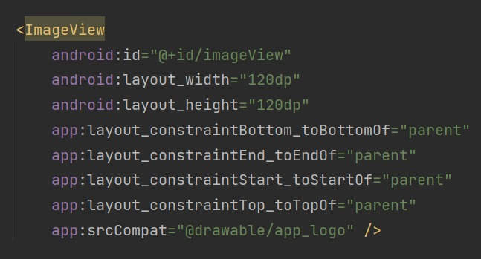
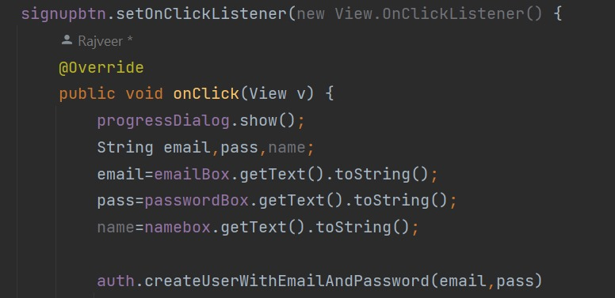
Some code Snippets

Slide 9
Features
Seamless Video Conferencing
Screen Sharing
User Authentication
User Data Management
Various common video calling features.

Slide 10
Results
The main result that has been obtained after the implementation of the whole project is that the android application has made it easy for two users to communicate on any device according to their convenience and ease.

Slide 11
Challenges Faced
Implementing the real-time communication was one of the challenges that we faced during the making of this project.
In order to overcome this difficulty we successfully implemented Android Socket which accelerated the whole process of real-time communication between two parties.

Slide 12
Future Work
Additional features that can be added in our Video Conferencing application according to the latest need is a typing feature wherein users can chat while being on a video call.
Also the video conferencing application consists a feature in which at a time 5 members can participate in the single video conference meeting.

Slide 13
Conclusion
So far the presentation has covered the basics of our project, incorporating all the unique ideas that were raised by our team.
The project will allow its users to communicate with each other in meeting rooms, enabling our user to receive a request making it faster and easier to connect with everyone.

Slide 14
Acknowledgments
We would love to express our special thanks to our mentor Mr. Mohd. Asalam who supported us throughout the working of this project.
Also we would love to express our gratitude towards our teamates who have worked ethusiastically on this Video Conferencing Application.

